Slide 1

INTRODUCTION TO SUSTAINABILITY
MGT 1104
YEAR 1 – SEMESTER 1

Slide 2

SUSTAINABILITY – THE NEW ‘BUZZWORD’!
'Sustainability' is a term that has become very popular in the media and in academic circles in recent years. It has also become very fashionable for organizations and even countries itself to claim that they are sustainable in today's context (Pawson, 2001).
Despite of its fame, most people and companies tend to have very little knowledge on what the concept really entails and what it truly means to be sustainable.

Slide 3

WHAT IS SUSTAINABILITY?
In very simple terms, sustainability can be defined as:
'Development that meets the needs of the present without compromising on the ability of future generations to meet their own needs'
(WCED , 1987)

Slide 4

UNDERSTANDING SUSTAINABLE 'DEVELOPMENT'
When the word ‘development’ is mentioned, we immediately think of economic development. However, when it comes to sustainability, development means advancement in every area, including:
Economic Growth – Achieving economic progress
Social Progress – Facilitating the attaining of social equity and equality of opportunities for everybody, without social discrimination and equal prospects to obtain shelter, education, health care, jobs, etc.
Environmental Protection – Ensuring that resources are healthily recoverable, so they can also be enjoyed by coming generations
Notes:
Economic interests dene the framework for making decisions, the ow of nancial capital, and the facilitation of commerce, including the knowledge, skills, competences and other attributes embodied in individuals that are relevant to economic activity. Environmental aspects recognize the diversity and interdependence within living systems, the goods and services produced by the world's ecosystems, and the impacts of human wastes. Socio-political refers to interactions between institutions/rms and people, functions expressive of human values, aspirations and well-being, ethical issues, and decisionmaking that depends upon collective action

Slide 5
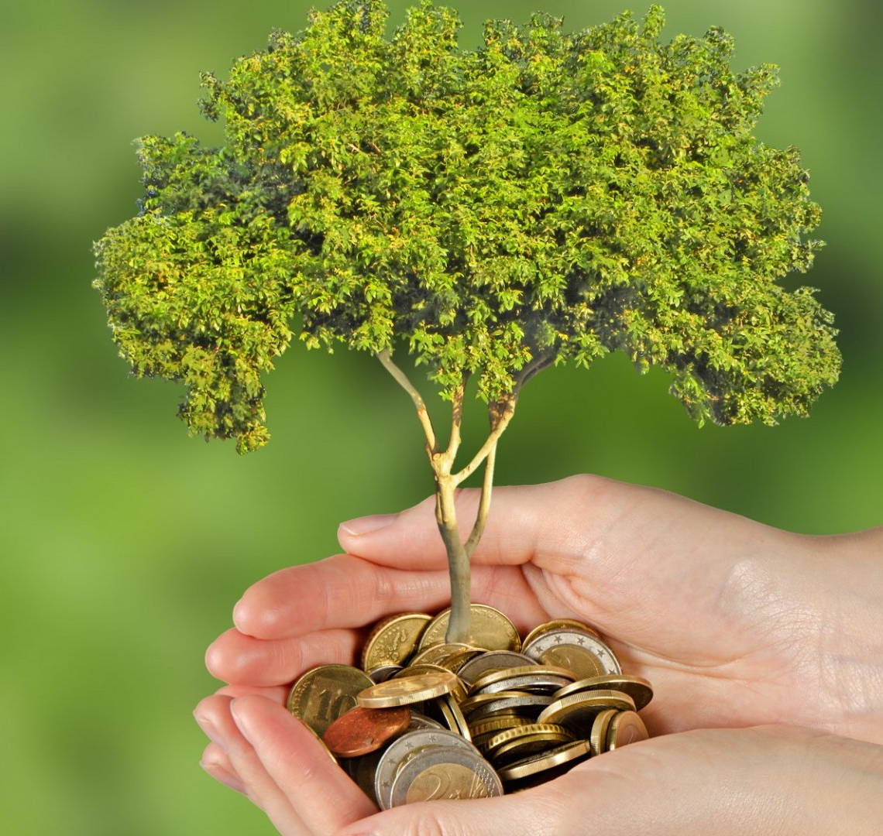
SUSTAINABLE DEVELOPMENT OVER ECONOMIC GROWTH?
The biggest challenge when discussing the concept of sustainability is that most people believe that Sustainability and Development can't be achieved together
Therefore in present-day society, economic interest take precedence over environment and society
Economic growth alone however does not necessarily translate to better living standards
Societies must therefore look into finding an equilibrium of maintaining a healthy economic while taking care of its people and the environment.

Slide 6
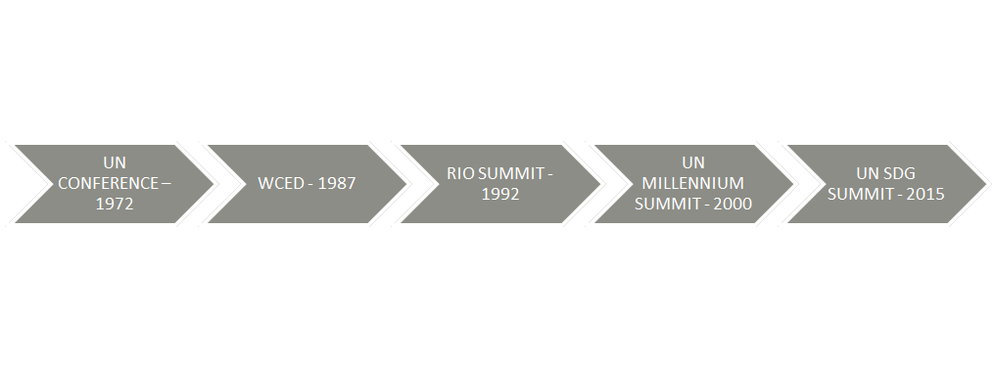
THE HISTORY & THE RISE OF SUSTAINABILITY CONCEPT
Sustainability concepts and concerns first emerged in early 1970's. From thereon, the world witnessed 5 major events that has shaped the way the sustainability concept is viewed, defined and operationalized at present.

Slide 7
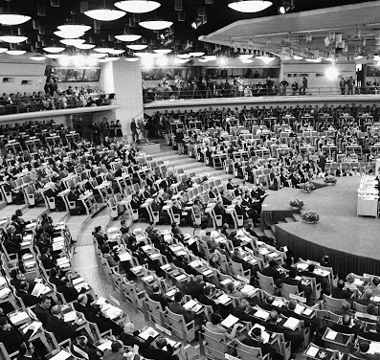
UN CONFERENCE ON ENVIRONMENT – 1972
The 1972 United Nations Conference on the Environment in Stockholm was the first world conference to make the environment a major issue.
The Stockholm Declaration, which contained 26 principles, placed environmental issues at the forefront of international concerns and marked the start of a dialogue between industrialized and developing countries on the link between economic growth, the pollution of the air, water, and oceans and the well-being of people around the world.

Slide 8
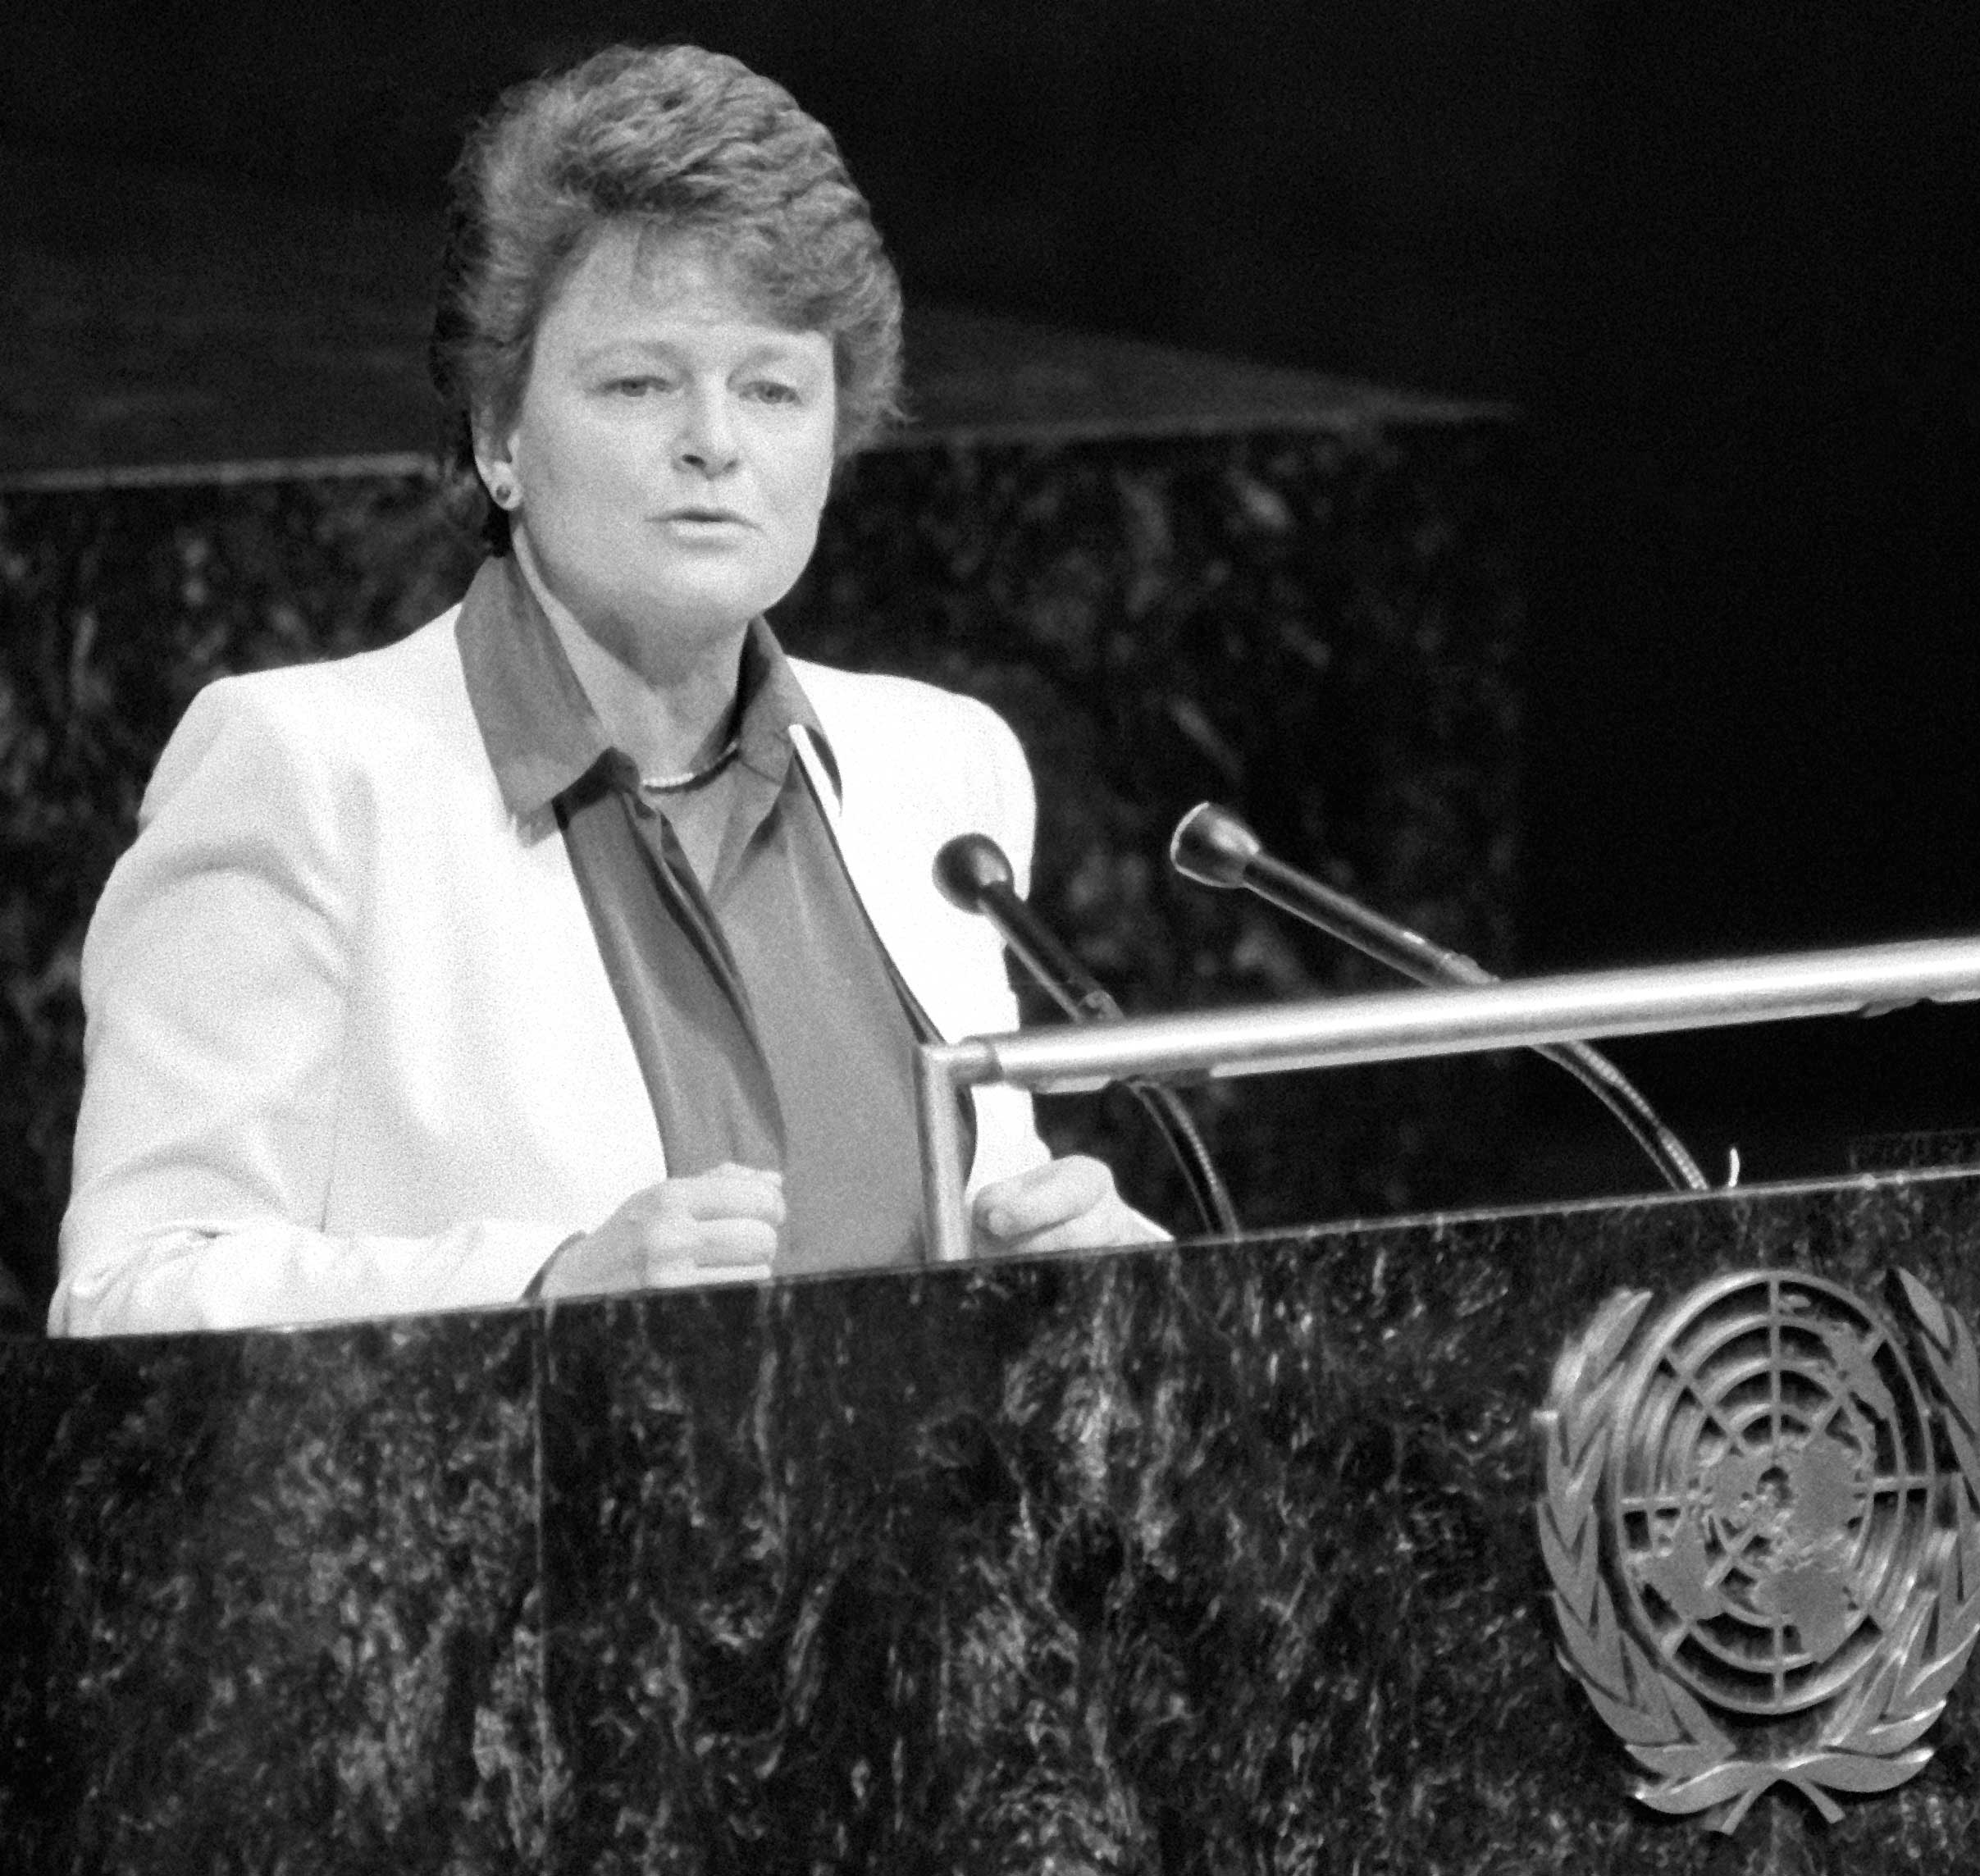
World Commission on Environment & Development (WCED) - 1987
The 1987 publication of the Bruntland report by the United Nations Commission headed by Norwegian Prime Minister Gro Harlem Brundtland proved to be a turning point in giving the word sustainability the meaning it now carries globally
The Brundtland Report firmly established the principle that the challenge to achieve sustainability involves an interplay between environmental and social factors.

Slide 9
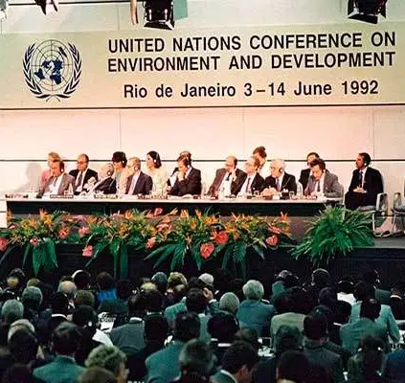
RIO SUMMIT – 1992
The United Nations Conference on Environment and Development (UNCED), also known as the 'Earth Summit', was held 1992 with the participation of 172 governments and 108 heads of state in attendance.
The Rio de Janeiro conference highlighted how different social, economic and environmental factors are interdependent and evolve together.
The Earth Summit was considered as a success due to a number of reasons but primarily due to the creation of Agenda 21, Rio Declaration and creation of the Commission on Sustainable Development

Slide 10
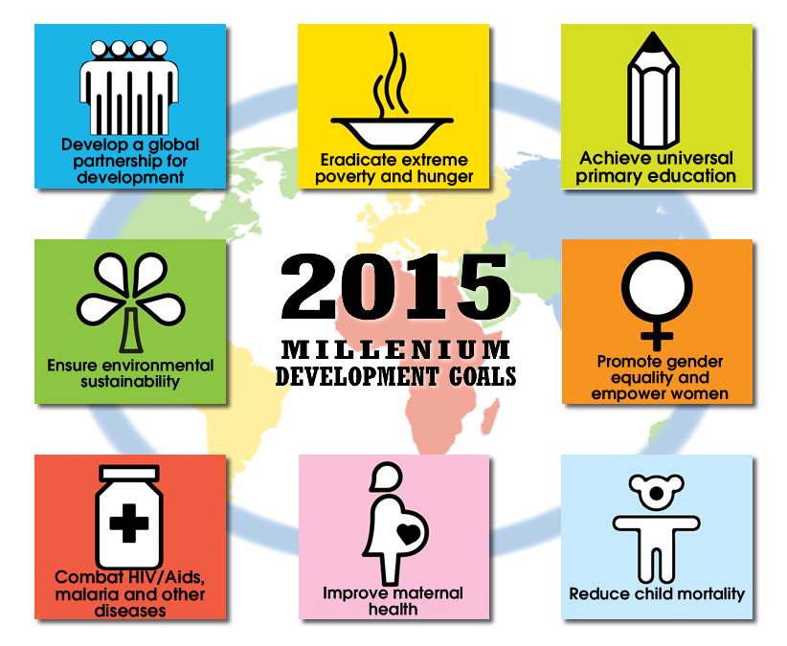
UN MILLENNIUM SUMMIT - 2000
The Millennium Summit was held in September 2000 at United Nations Headquarters in attendance of 149 Heads of State and Government and high-ranking officials to unanimously adopt, the Millennium Declaration.
The world leaders who gathered at the Summit committed their nations to a new global partnership to achieve global sustainability through a series of time-bound targets, with a deadline of 2015, that have since become known as the Millennium Development Goals.

Slide 11
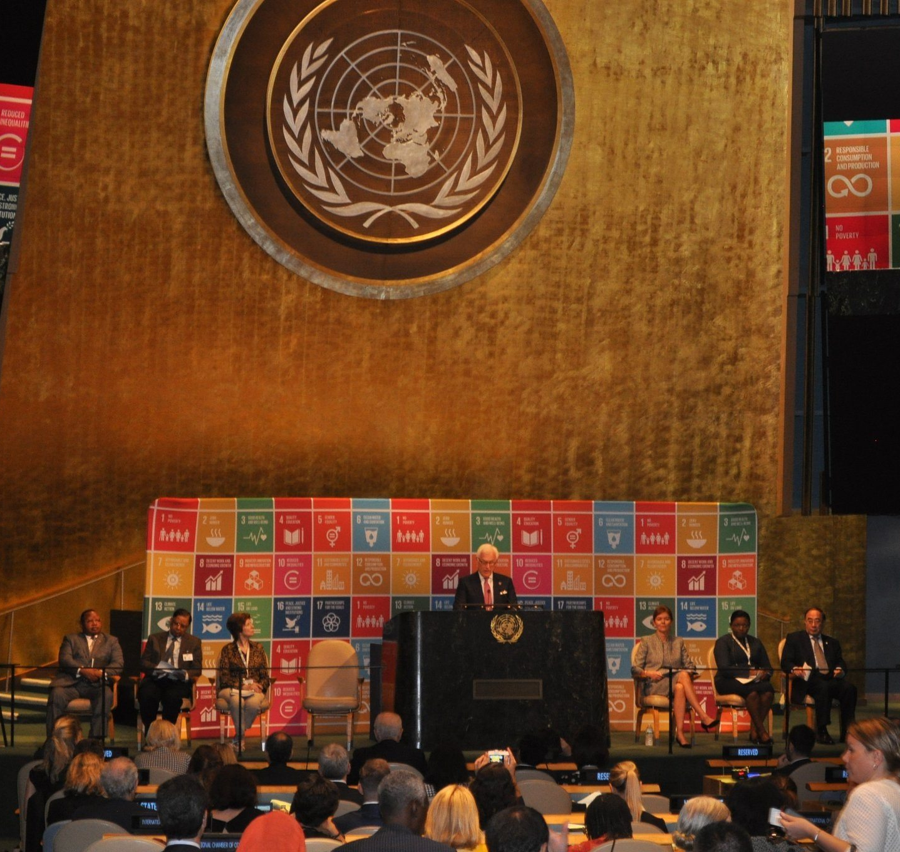
UN Sustainable Development Summit – 2015
At the landmark Sustainable Development Summit held in 2015 September at UN Headquarters in New York, 193 countries officially adopted the historic new agenda, entitled “Transforming Our World: The 2030 Agenda for Sustainable Development,” I.e. the 17 Sustainable Development Goals (SDGs).
The new agenda is people-centred, universal, transformative and integrated. It calls for action by all countries for all people over the next 15 years in five areas of critical importance: people, planet, prosperity, peace and partnership.

Slide 12
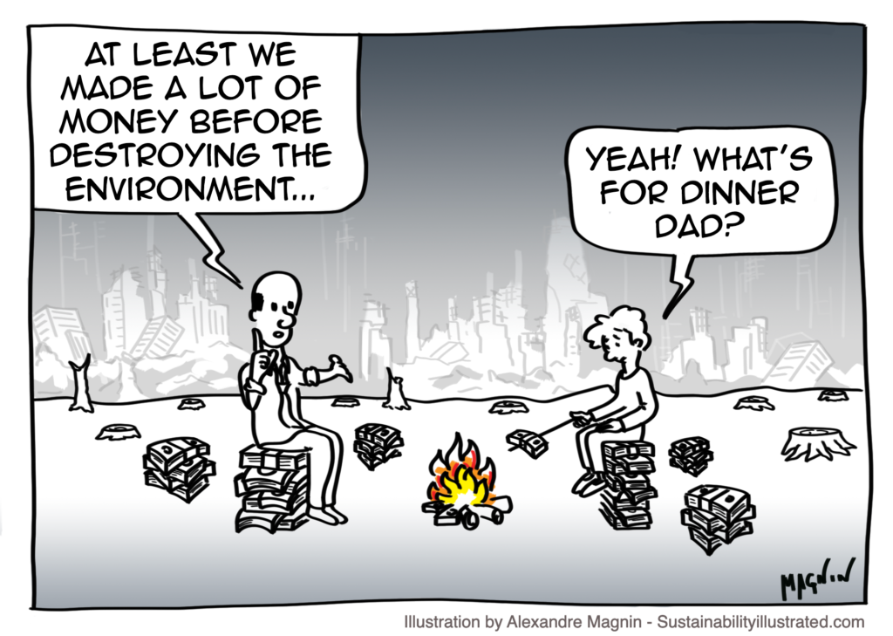
UNDERSTANDING THE MAIN CHALLENGE OF SUSTAINABILITY
In some instances it may be necessary to degrade a particular ecosystem in order to facilitate commerce, or food production, or housing. If the option is given to priorotize humans will continue to only focus on the economic aspect of sustainability
Economic and social systems are human creations, the environment is not
The harmful effects of the degradation of ecosystem services are being borne disproportionately globally with several countries suffering from consequences way more than the other

Slide 13
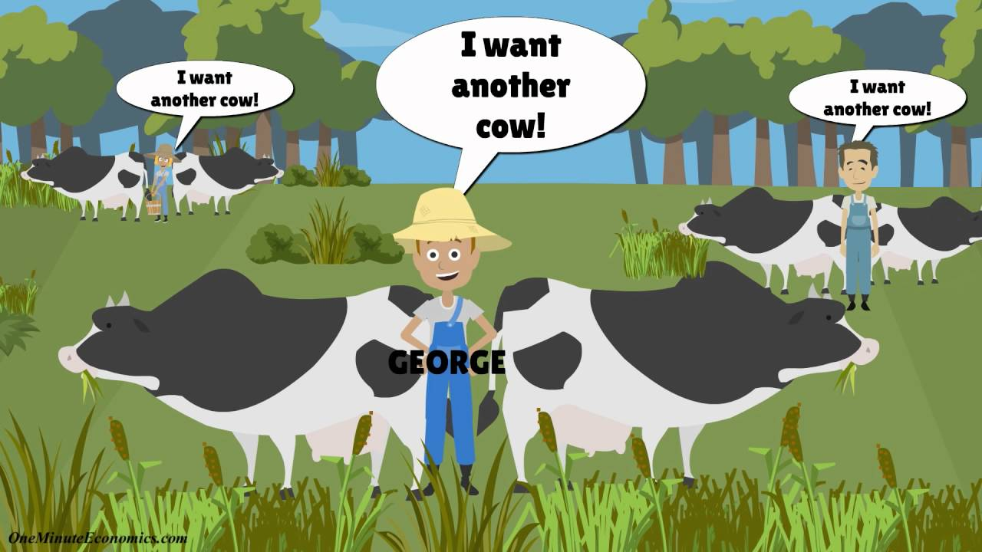
WHAT IS TRAGEDY OF THE COMMONS?
Tragedy of the Commons is an economic problem where individuals have access to a shared resource and act in their own interest, at the expense of other individuals. This can result in overconsumption, underinvestment, and depletion of resources (Earth.org, 2020).
https://www.youtube.com/watch?v=CxC161GvMPc

Slide 14
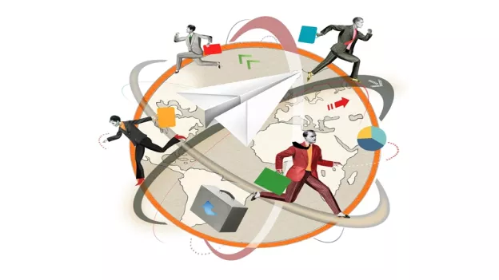
GLOBALIZATION AND SUSTAINABILITY
Globalization has created a platform for worldwide integration where people communicate, travel, invest internationally and companies market their products across continents while acquiring human and capital resources more efficiently .
While globalization has contributed vastly to global development, it has also resulted in the damage and degradation of certain local environments and cultures as well.

Slide 15
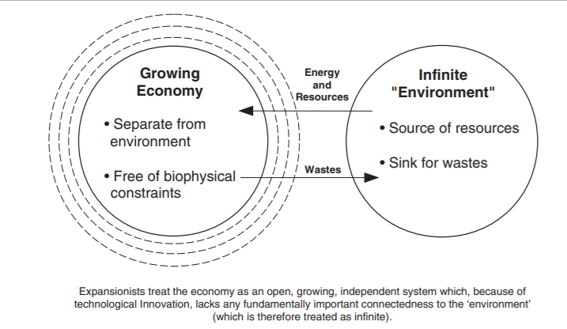
GLOBALIZATION VS SUSTAINABILITY - IDENTIFYING THE PROBLEM
Globalization has resulted in country's identifying their economies as independent, self-regulating, and self-sustaining system whose productivity and growth does not seriously constrain the environment.
Hence country's/ coporations believe that any mastery achieved by humans through globalization through technology and other advancements will be able to compensate for the depletion of any important natural resource.

Slide 16

HYPERCONSUMPTION
Unsustainable use of natural resources and environmental pollution
Loss of global biodiversity and habitats for non-human species
Increasing emissions of ‘greenhouse gases’ that are leading to global warming

Slide 17
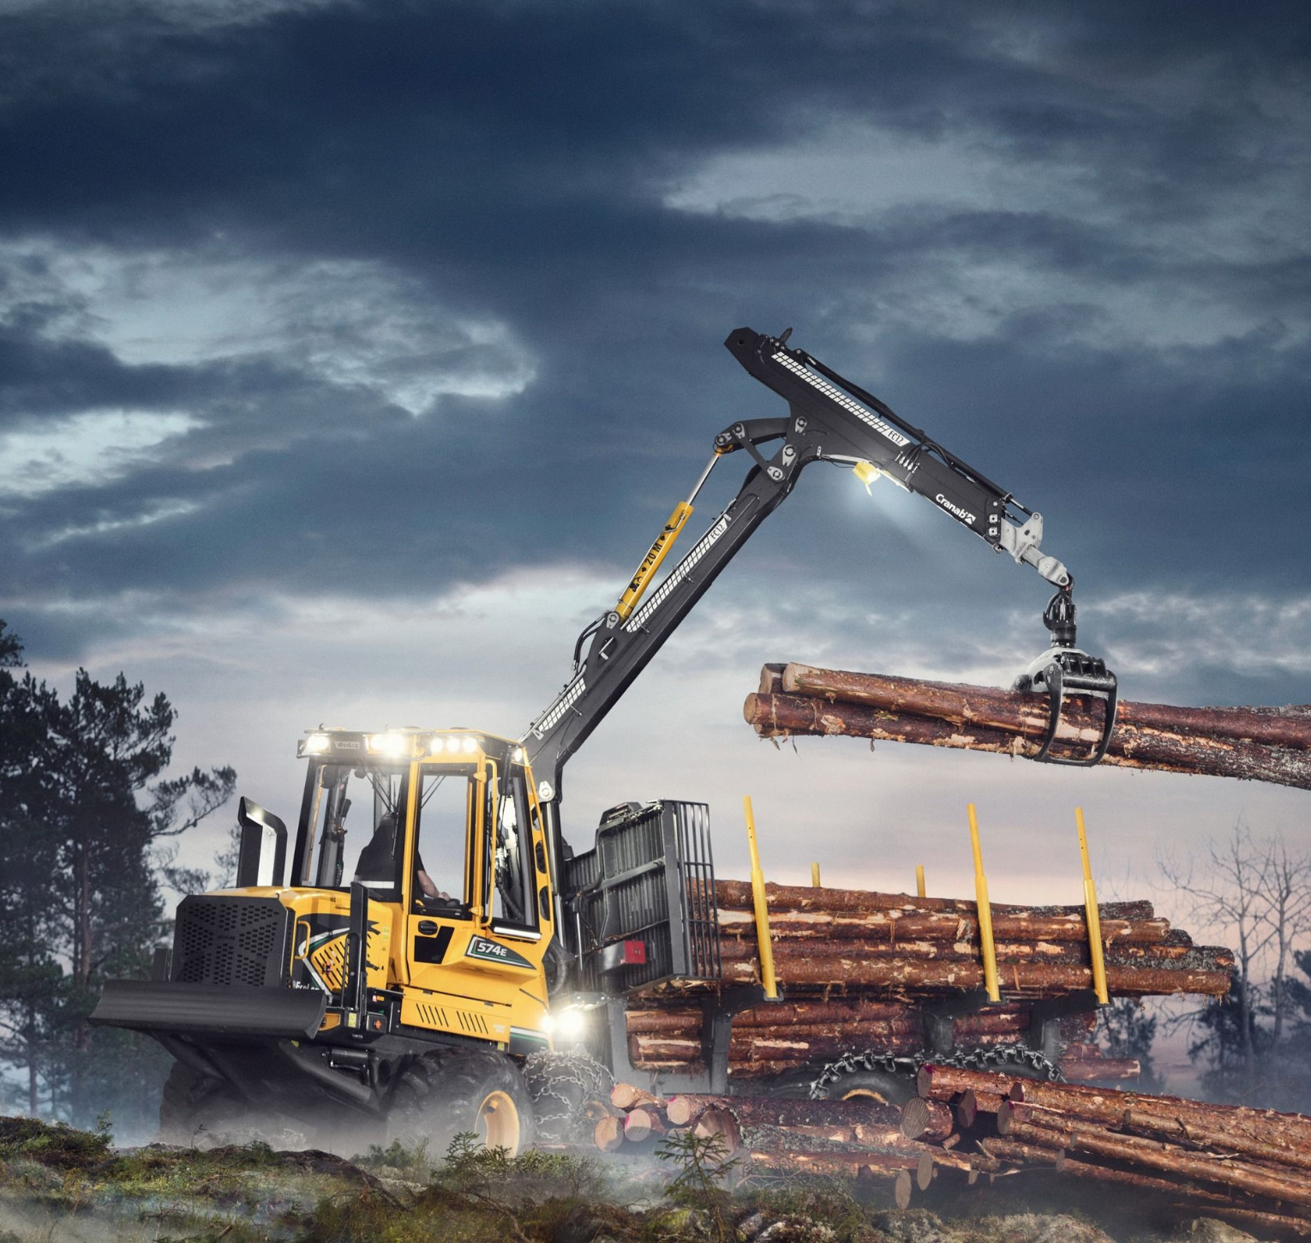
HYPERCONSUMPTION
Rising economic costs related to increasing production and transport of goods and the disposal of increasing volumes of waste
Loss of social connectedness and a sense of belonging to community
Stresses associated with working hard to sustain high levels of consumption

